Slide 1

mid semester project
Is It Possible To Predict House Price ?
Tamara Baybachov 308240936
Ron Gershburg 313164766

Slide 2
Research Question and Variables
Is It Possible To Predict the price of presidential Houses with regression machine learning methods?
Variables –
x = [x1,x2,x3,…,x80] – Features
y = SalePrice – Target feature ( the feature that we want to predict)
Sample - number of entries (samples) in the training Dataset
α - model’s parameter(in our case lasso’s)

Slide 3
The Method
Data Exploration
Pre-Processing
Training
Prediction

Slide 4

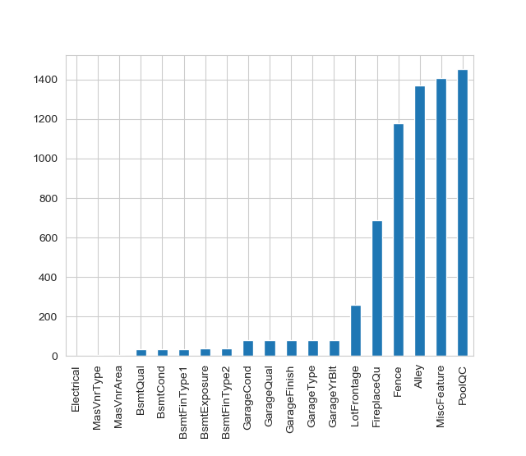
Data Exploration
1) Missing Data
In order to do pre-processing we have to observe the data and see its disadvantages.
To that end, we visualized the data with different plots.
At the current plot we can see the features that lack an amount of data.
We can see that there are features that have around 1400 samples missing, this can really affect our model .
We would like to address that problem as part of our pre-processing.

Slide 5
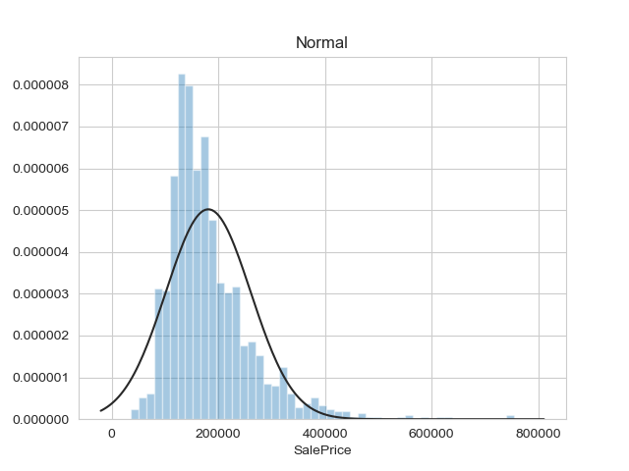
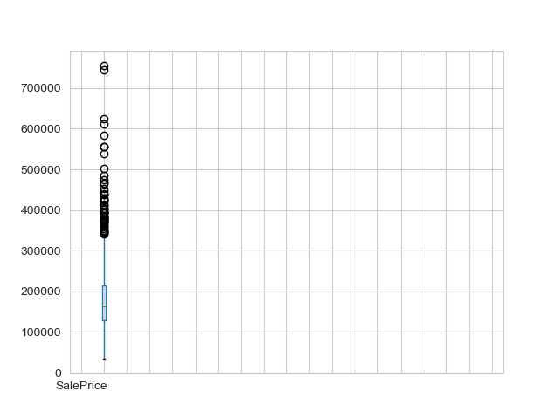
Data Exploration
2) Sales price distribution
In [2] we can see our SalePrice data compared distribution compared to normal distribution. In class we learned that normal distributed data preforms best in machine learning models, thus our goal is to approximate our data’s distribution to the normal distribution.
In [3] we can see that there are many outliers and that the variance is high. Therefore we would like to fix this in the pre-processing.
3) Sale price boxplot

Slide 6
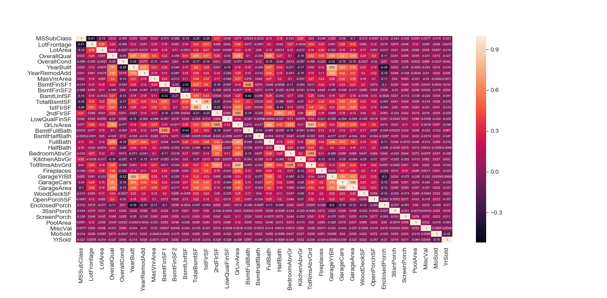
Pre-Processing
Fig used to analyze correlation between features
In order to center ‘SalePrice’ and other features around the mean and approximate them to normal distribution , we activated the transformations on the training data. (such as log transform)
We dropped features that are high correlated with other features (between the high correlated we left the feature with the higher correlation with ‘saleprice’)
We added new features in order to enhance model performance, we added them by combining features ( for example adding total square footage by adding the samples of all square footage features)
We converted categorical data to numerical as models don’t work with text data.
We normalized the data in order handle outliers.

Slide 7

Training
Model – We used Lasso regression . Lasso regression is a type of linear regression that uses shrinkage. Shrinkage is where data values are shrunk towards a central point, like the mean. The lasso procedure encourages simple, sparse models (i.e. models with fewer parameters)
Lasso: where α is is λ python’s lasso function.
We trained the model with different ‘α’ and chose ‘α’ that gives us the best result.

Slide 8
Prediction
Training data had 1458 samples and test data had 1459 samples(we got the test data and training as default at the beginning of the Kaggle challenge)
Score was calculated with root mean squared logarithmic error
Several models with varying parameters were created and their performances were compared.

Slide 9
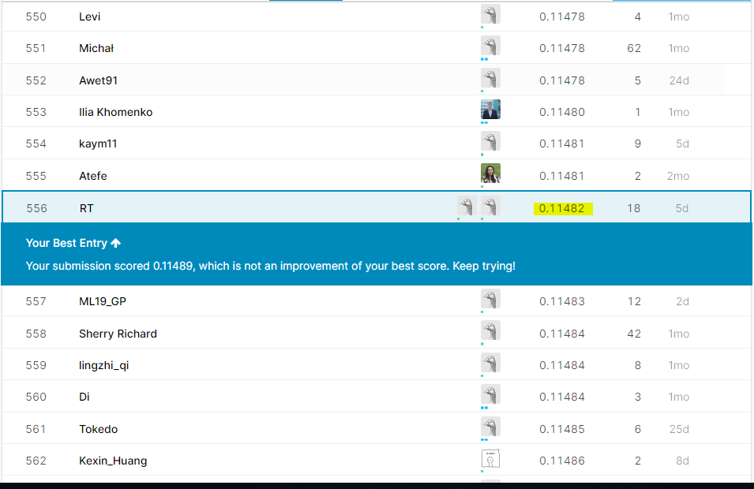
Results

Slide 10
Conclusions
Removing features that lack more than 90% of the data gave us better results than giving them mean value of the feature.
Adding new features that are based on multiple other features , enchanted our model’s performance.
Approximating our data to normal distribution improved significantly our results
Overfitting might of hurt our model’s performance

